Slide 1
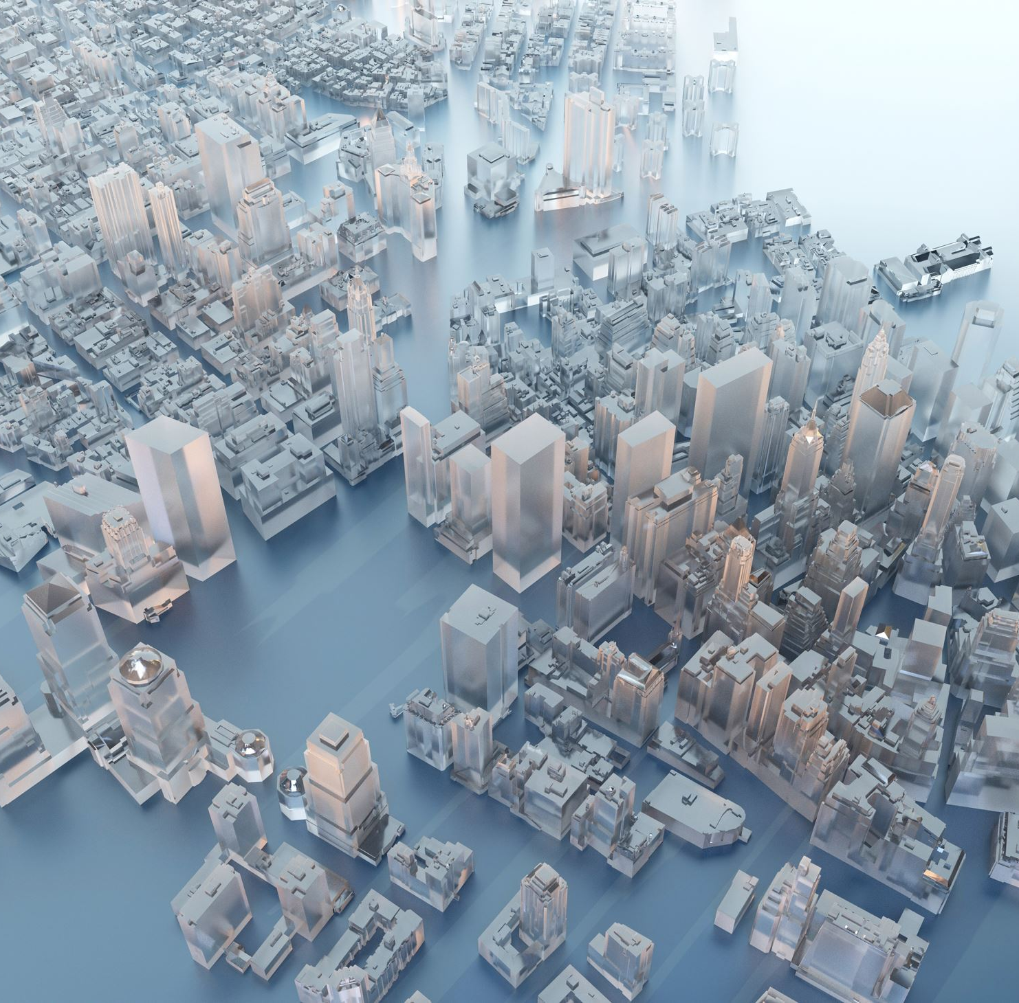
The Use of Augmented Reality in Locating and Virtually Replicating Landmarks
Author: Lazăr Răzvan-Andrei
Supervisor: Lect. Dr. Lazăr Ioan

Slide 2
Contents 1. Introduction 2. Literature review 3. Coordinate systems 4. WanderAR: Server Side 5. WanderAR: Client Application 6. Conclusions and future work Bibliography

Slide 3






Augmented Reality Assisted
Landmark Navigation
WanderAR
Navigation Models
Localisation
Landmark Positioning
Demo

Slide 4
What is augmented reality assisted landmark navigation?

Slide 5
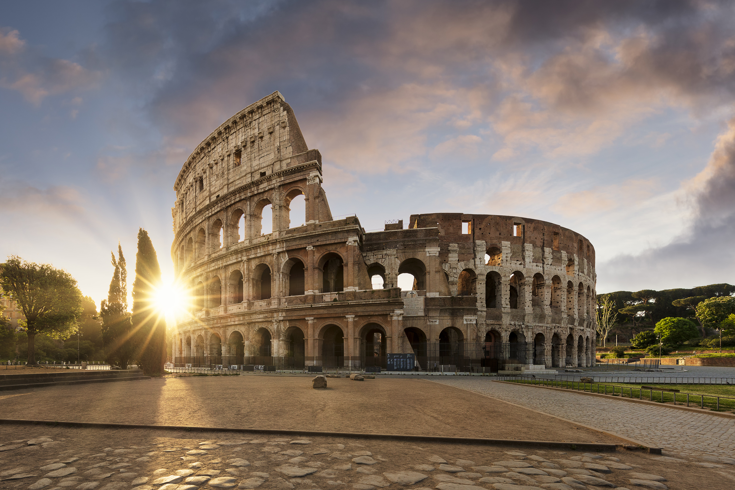
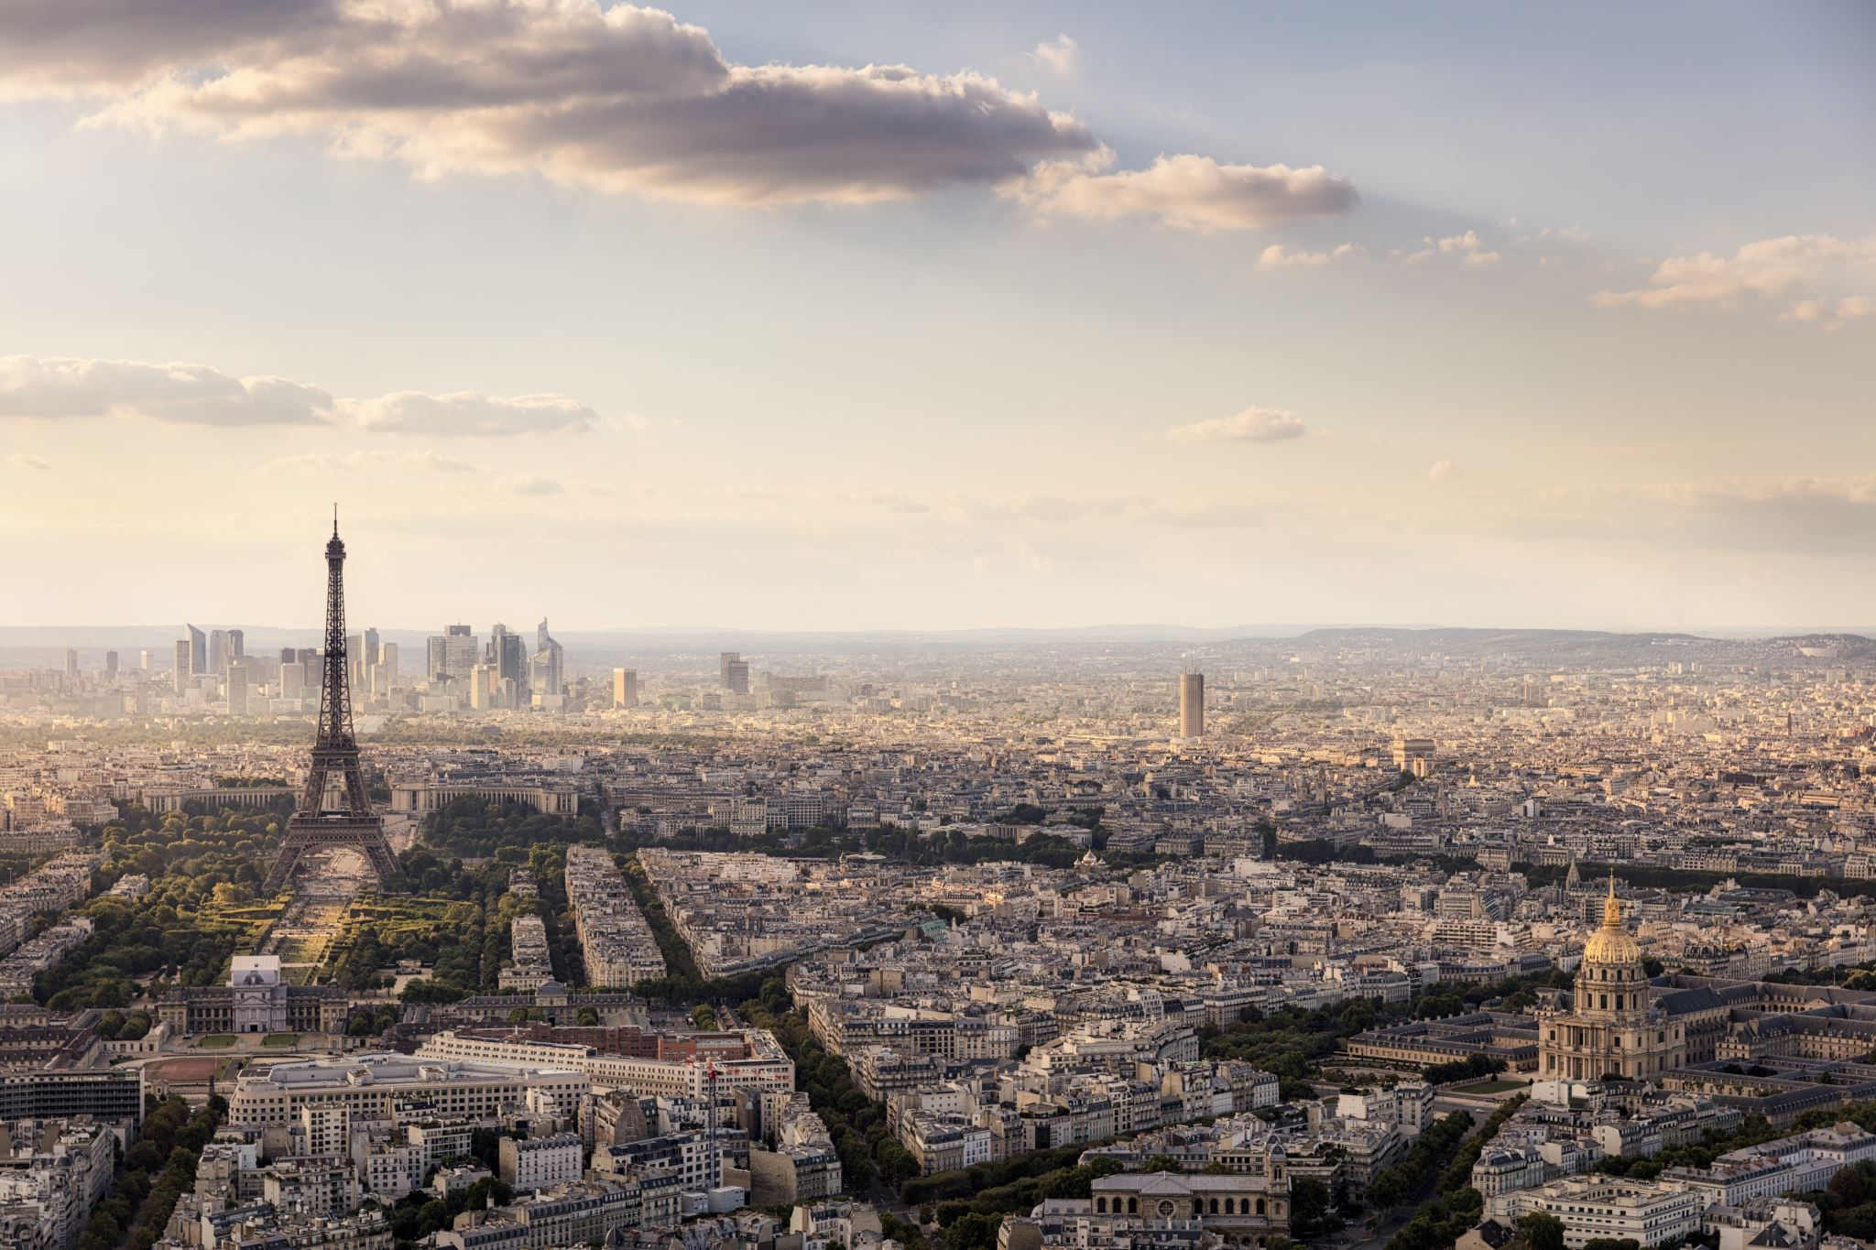
What is augmented reality assisted landmark navigation?
I. AR Assisted Landmark navigation
Landmark Navigation
Foundation block for human orientation
Critical for the memorisation of a new environment

Slide 6
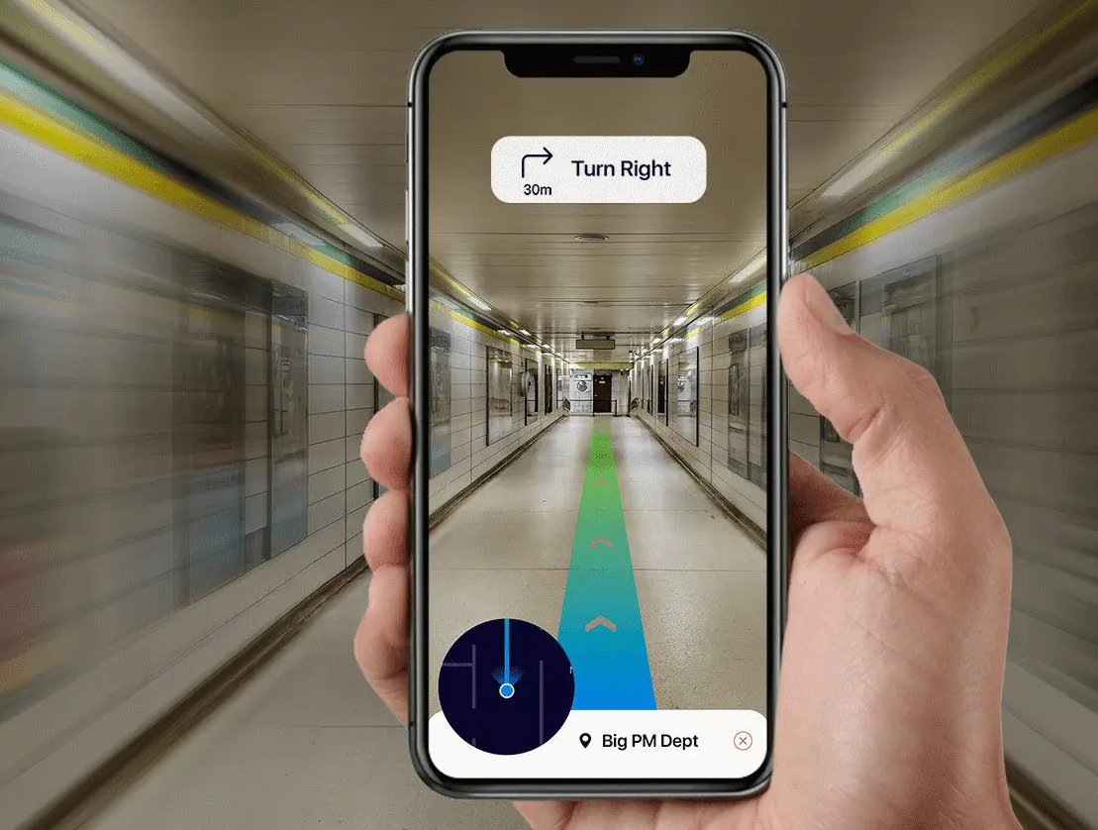
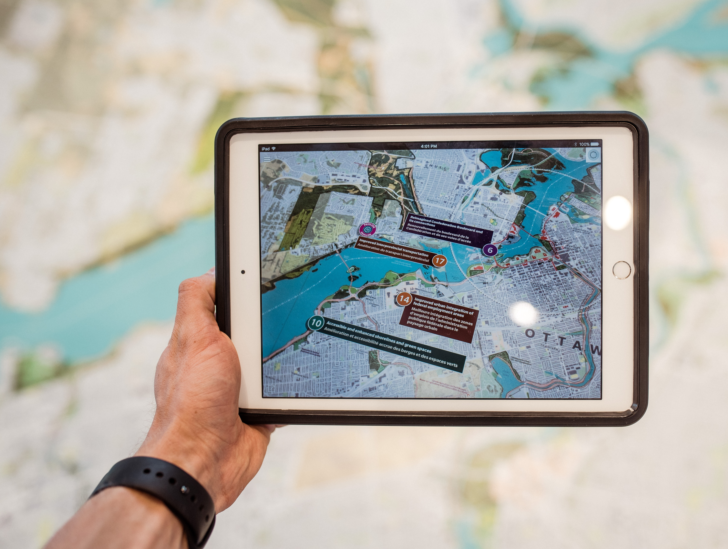
What is augmented reality assisted landmark navigation?
I. AR Assisted Landmark navigation
Augmented Reality navigation
The future of immersive navigation
The fusion between reality and imagination

Slide 7
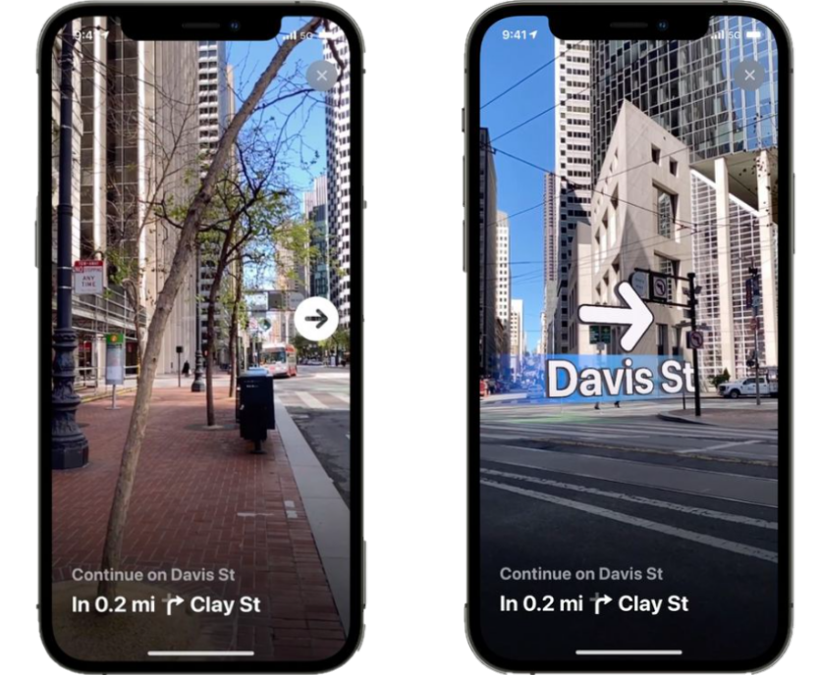
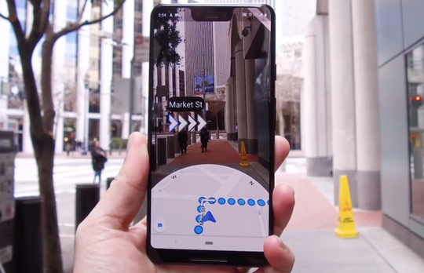
Present
I. AR Assisted Landmark navigation
Google Maps: Live View
Apple Maps AR
Google Geospatial Creator
Google Maps: Live View
Apple Maps AR

Slide 8
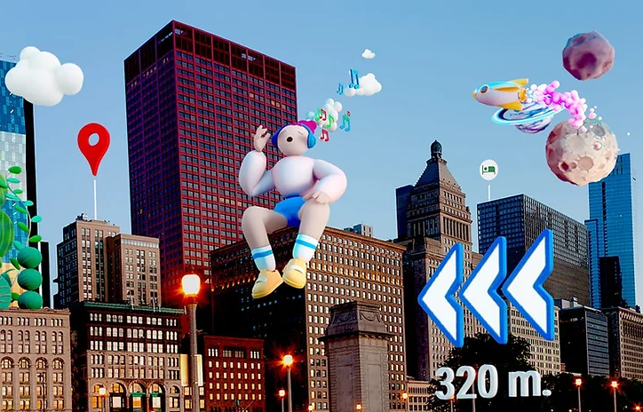
Present
I. AR Assisted Landmark navigation
Google Maps: Live View
Apple Maps AR
Google Geospatial Creator
Apple Maps AR
Google Geospatial Creator

Slide 9
Present
I. AR Assisted Landmark navigation
Google Maps: Live View
Apple Maps AR
Google Geospatial Creator
Google Geospatial Creator

Slide 10
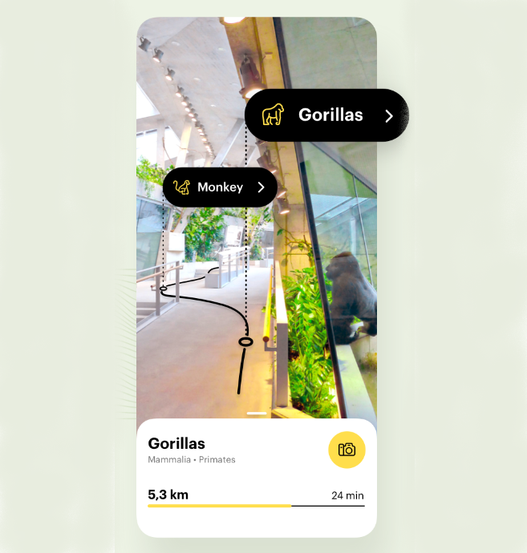
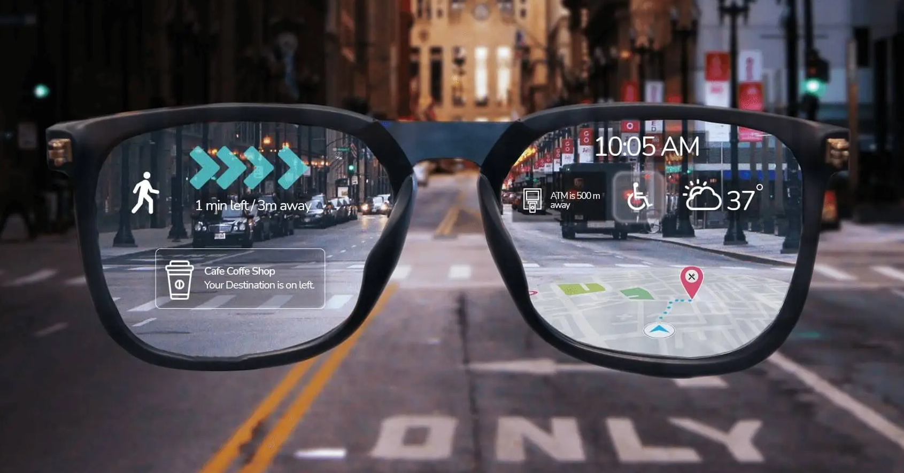
I. AR Assisted Landmark navigation
Future
Augmented museum or zoo maps
Navigation through Augmented Reality glasses
Augmented windshield for automotive
Augmented zoo map
Augmented Reality glasses

Slide 11
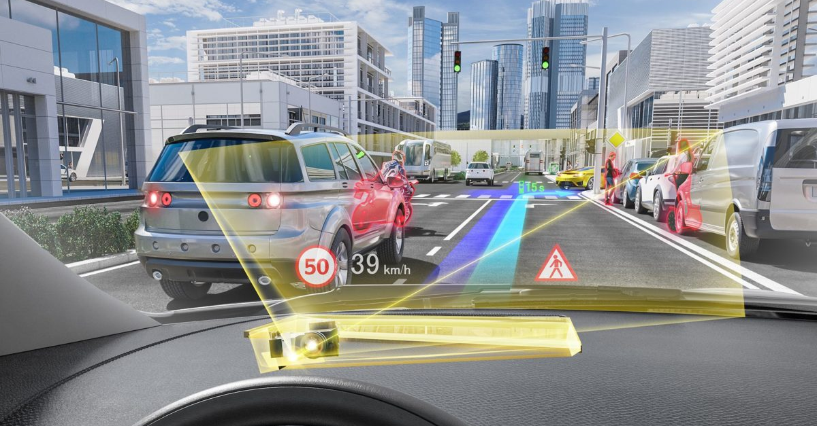
I. AR Assisted Landmark navigation
Future
Augmented museum or zoo maps
Navigation through Augmented Reality glasses
Augmented windshield for automotive
Augmented Reality glasses
Augmented windshield

Slide 12
I. AR Assisted Landmark navigation
Future
Augmented museum or zoo maps
Navigation through Augmented Reality glasses
Augmented windshield for automotive
Augmented windshield

Slide 13
WanderAR

Slide 14
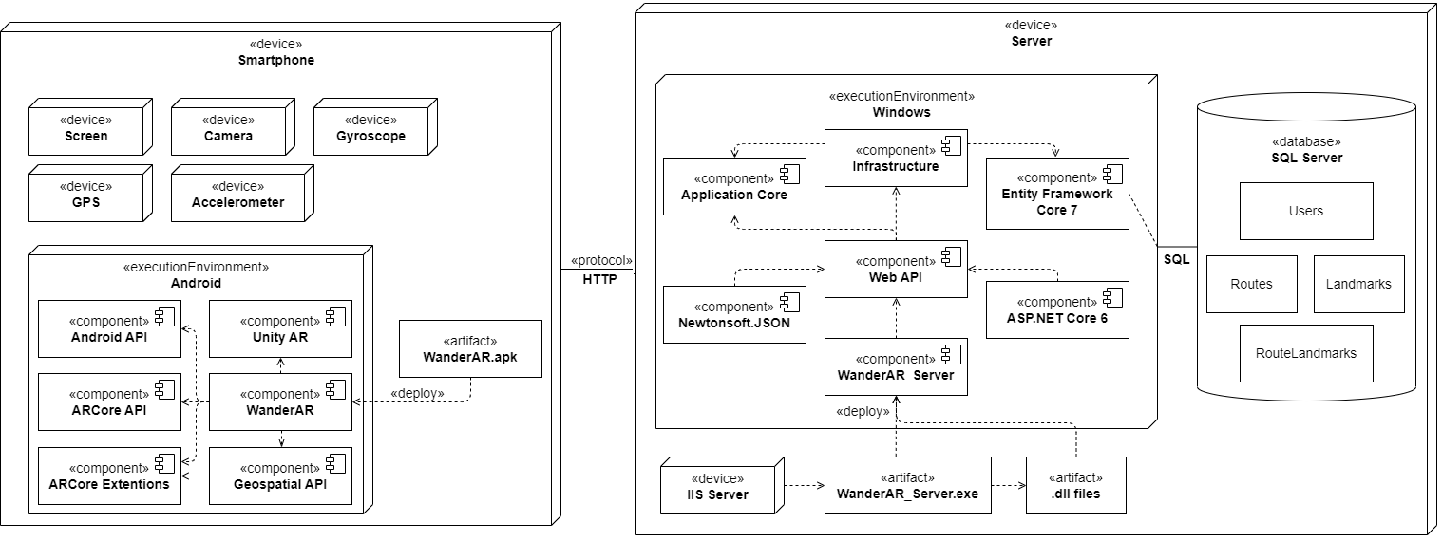
Architecture
II. WanderAR
Stores data;
Facilitates user-specific content;
Provides access to data via an API;
Offers security to personal data.
Built for Android;
Created using the Unity game engine;
The Augmented Reality integration is done using ARCore;
Communicates with the server using HTTP requests.

Slide 15



Examples of landmark navigation
III. Navigation models
Single landmark navigation
Route navigation
Proximity navigation

Slide 16
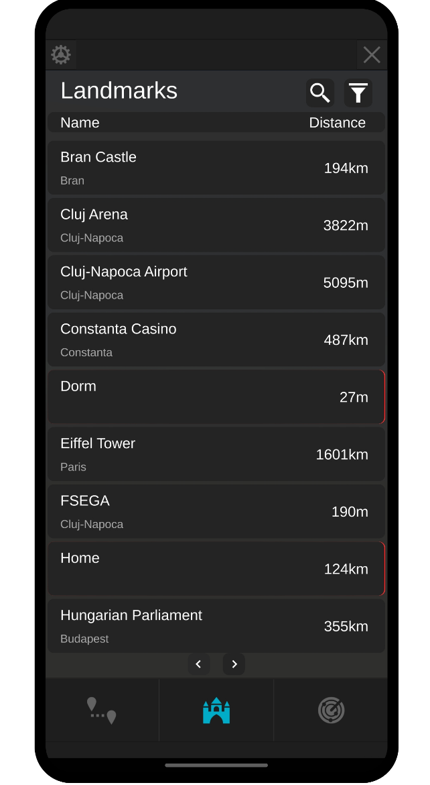
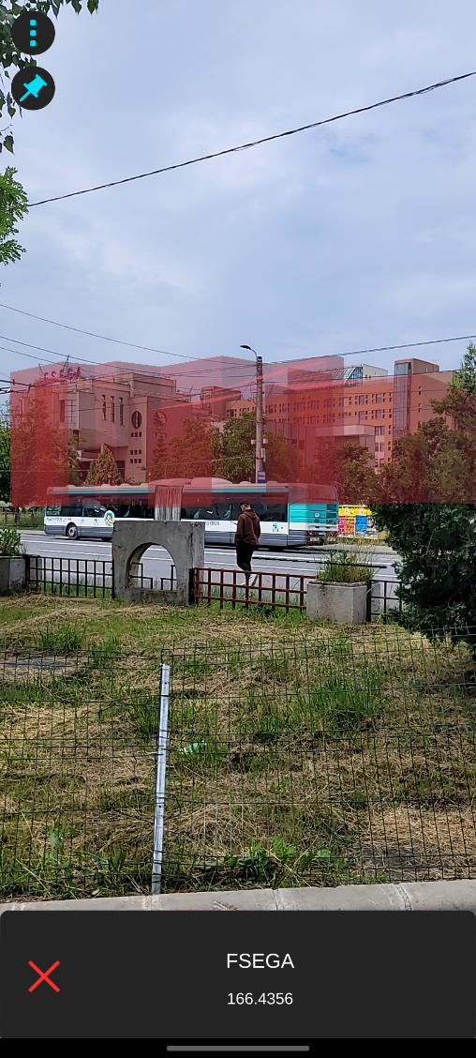
III. Navigation models
Proximity navigation
Single landmark navigation
Loads only one landmark at a time.
Route navigation

Slide 17
III. Navigation models
Examples of landmark navigation
Single landmark navigation
Route navigation
Proximity navigation

Slide 18
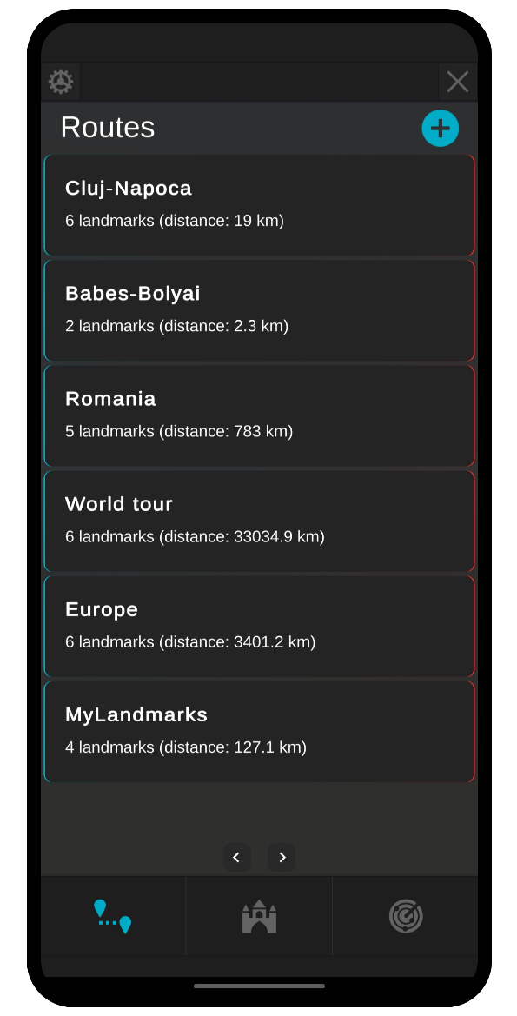
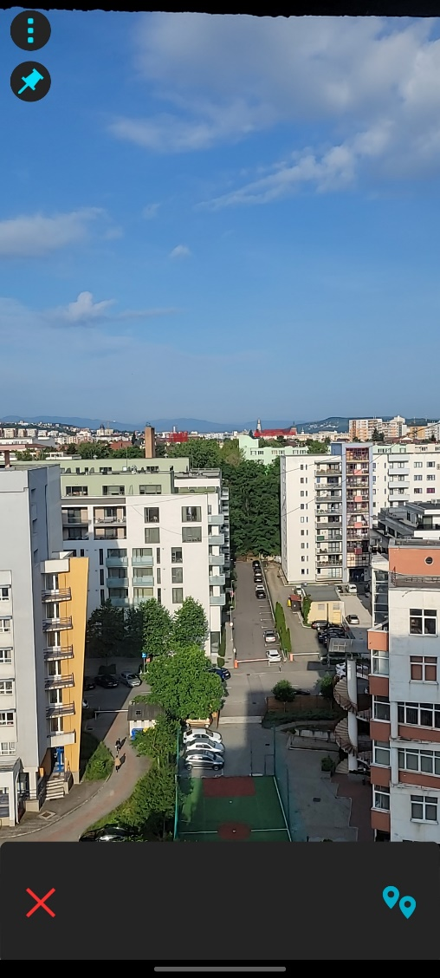
III. Navigation models
Route navigation
Custom routes, composed of multiple landmarks.
One By One
Only one landmark is loaded at a time;
Go to the next or previous landmark of the route.
All At Once
All landmarks in the route are loaded and displayed.
Single landmark navigation
Proximity navigation

Slide 19
III. Navigation models
Examples of landmark navigation
Single landmark navigation
Route navigation
Proximity navigation

Slide 20
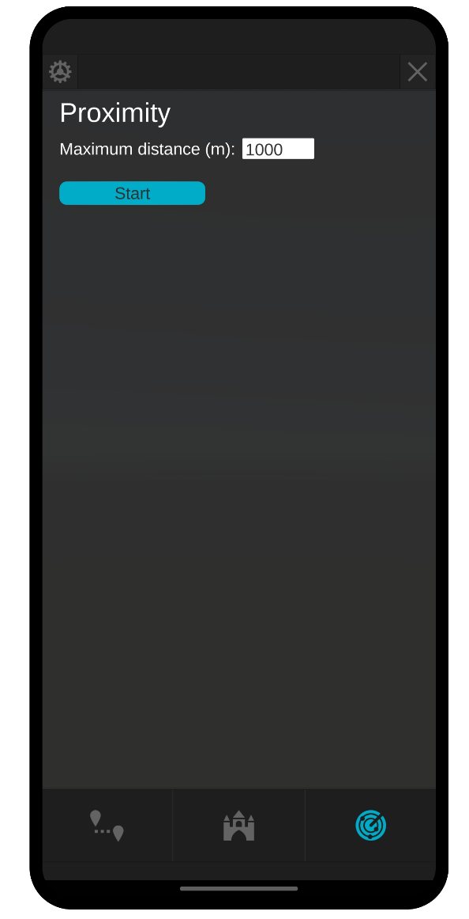
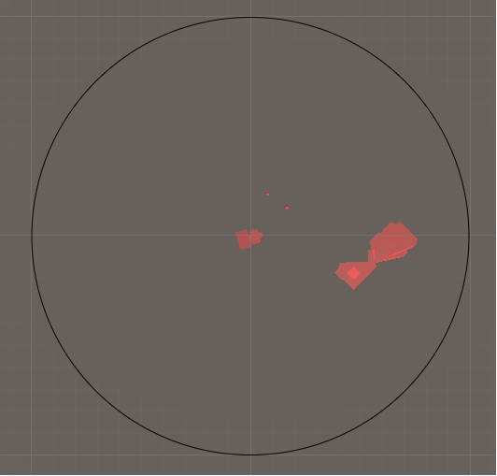
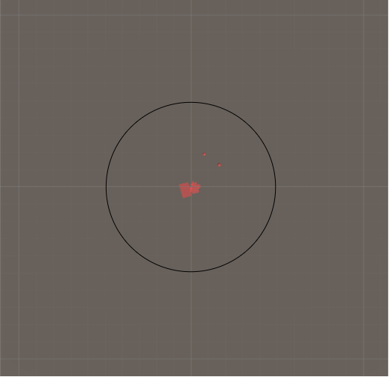
III. Navigation models
Proximity navigation
Single landmark navigation
All landmarks in a selected radius are loaded.
Radius:
500 m
Radius:
1000 m
Route navigation

Slide 21
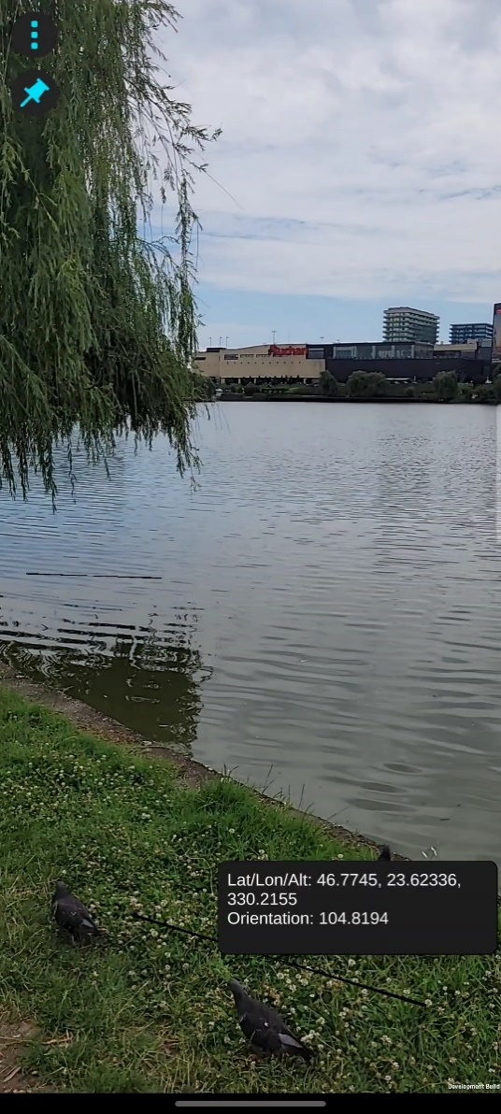
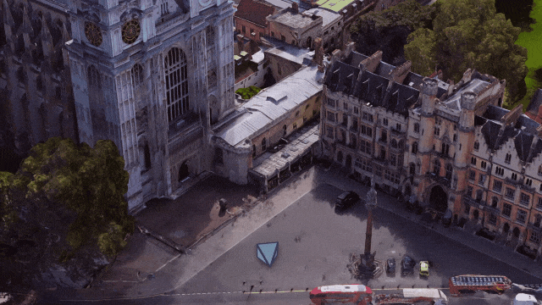
Real-world localisation
IV. Localisation
Device geodetic coordinates
Device orientation
Google’s Geospatial API

Slide 22
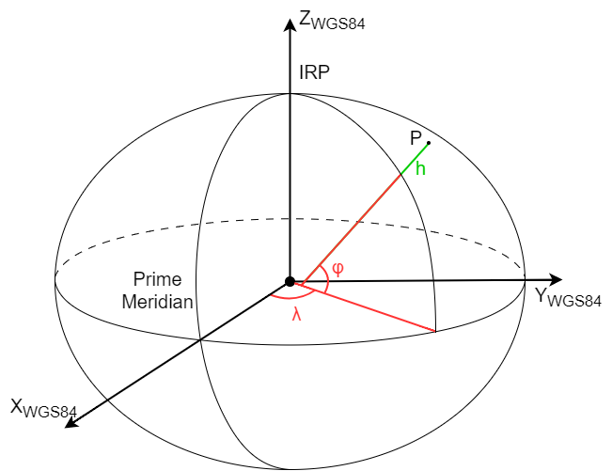
Landmark positioning and navigation
V. Landmark positioning
Geodetic: latitude (φ), longitude(λ), altitude(h)

Slide 23
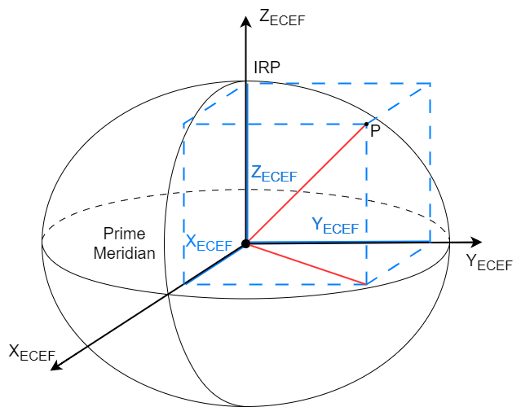
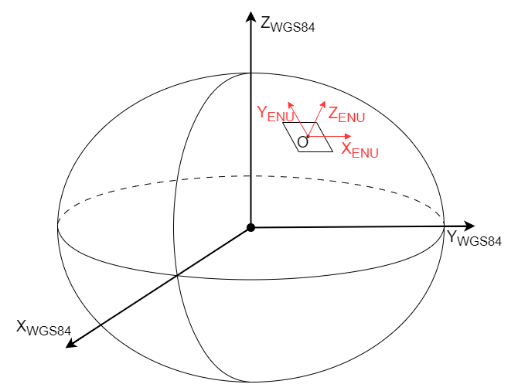
Long distance (> 50km)
V. Landmark positioning
Geodetic: latitude (φ), longitude(λ), altitude(h)
Earth-First-Earth-Centre: X, Y, Z

Slide 24
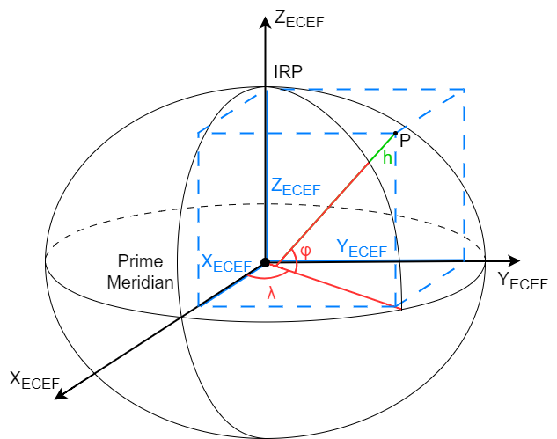
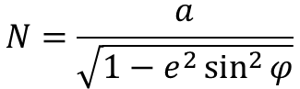
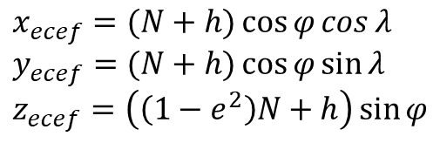
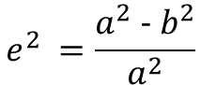
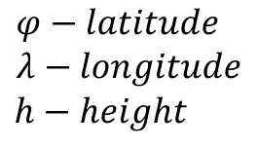
Long distance
V. Landmark positioning
$$φ−latitude \\ λ−longitude$$
$$h−height$$
$$x_{ecef}=(N+h)\cos{φ}\cos{λ} \\ y_{ecef}=(N+h)\cos{φ}\sin{λ} \\ z_{ecef}=\left(\left(1−e^{2}\right)N+h\right)\sin{φ}$$
$$N=\frac{a}{\sqrt{1−e^{2}\sin^{2}{φ}}}$$
- radius of curvature in the prime vertical
$$e^{2} =\frac{a^{2} − b^{2}}{a^{2}}$$
-eccentricity of the Earth

Slide 25
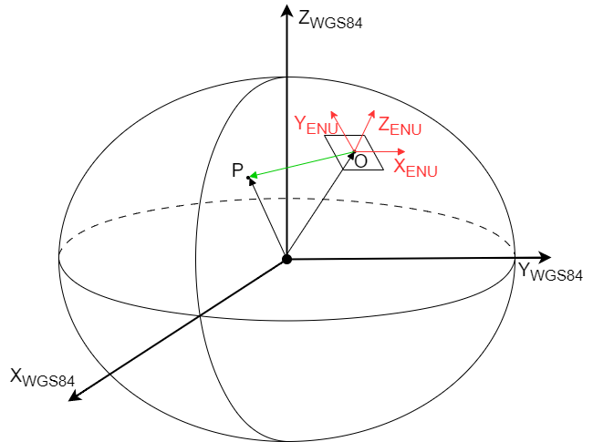
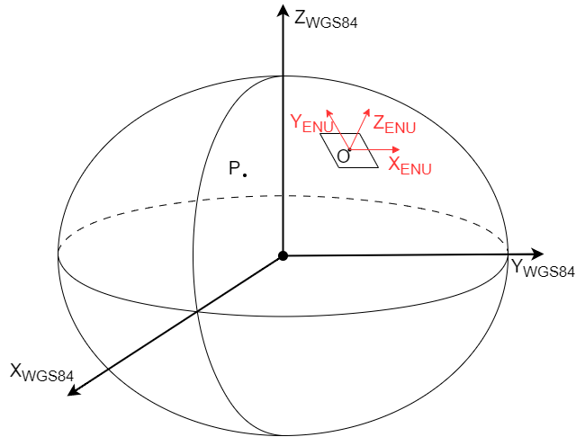
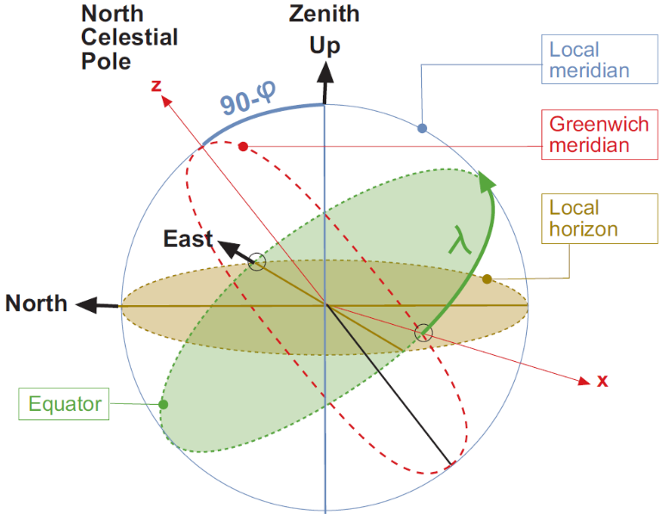
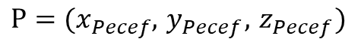
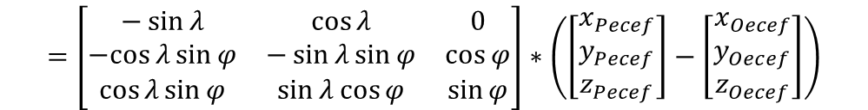
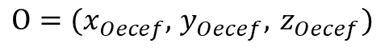
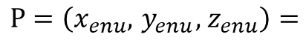
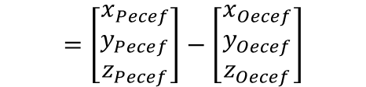
Long distance
V. Landmark positioning
$$φ−latitude \\ λ−longitude$$
$$h−height$$
$$O=(x_{Oecef}, { y}_{Oecef}, { z}_{Oecef})$$
$$P=(x_{Pecef}, { y}_{Pecef}, { z}_{Pecef})$$
$$P=\left(x_{enu}, { y}_{enu}, { z}_{enu}\right)=$$
$$=\left[\begin{matrix}−\sin{λ} & \cos{λ} & 0 \\ −cos{λ}\sin{φ} & −\sin{λ}\sin{φ} & \cos{φ} \\ \cos{λ}\sin{φ} & \sin{λ}\cos{φ} & \sin{φ}\end{matrix}\right]∗\left(\left[\begin{matrix}x_{Pecef} \\ y_{Pecef} \\ z_{Pecef}\end{matrix}\right]−\left[\begin{matrix}x_{Oecef} \\ y_{Oecef} \\ z_{Oecef}\end{matrix}\right]\right)$$
$$=\left[\begin{matrix}x_{Pecef} \\ y_{Pecef} \\ z_{Pecef}\end{matrix}\right]−\left[\begin{matrix}x_{Oecef} \\ y_{Oecef} \\ z_{Oecef}\end{matrix}\right]$$

Slide 26
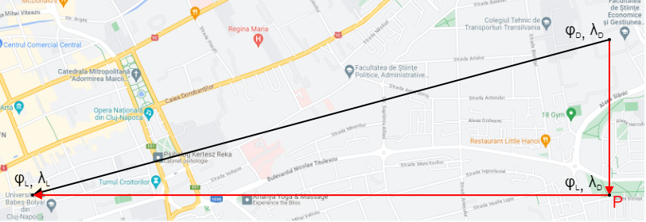
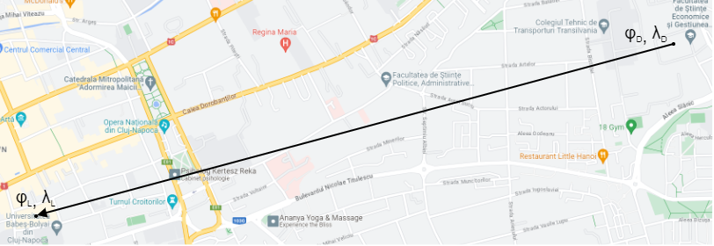
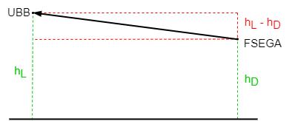
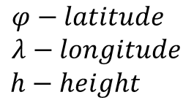
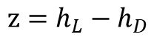
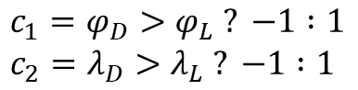
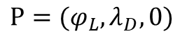
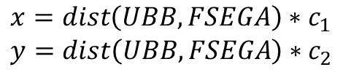
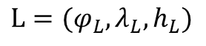
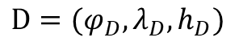
Short distance (< 50km)
V. Landmark positioning
$$D=(φ_{D},λ_{D},h_{D})$$
$$L=(φ_{L},λ_{L},h_{L})$$
$$P=(φ_{L},λ_{D},0)$$
$$x=dist\left(UBB, FSEGA\right)∗c_{1} \\ y=dist\left(UBB, FSEGA\right)∗c_{2}$$
$$c_{1}=φ_{D}>φ_{L} ? −1 :1 \\ c_{2}=λ_{D}>λ_{L} ? −1 :1$$
$$φ−latitude \\ λ−longitude$$
$$h−height$$
$$z=h_{L}−h_{D}$$

Slide 27
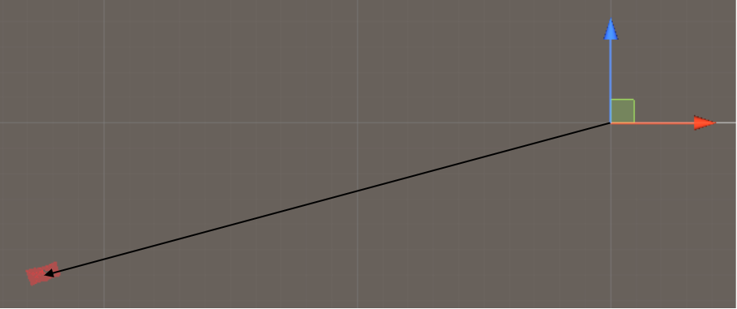
Synchronisation
V. Landmark positioning
Reality
Virtual

Slide 28
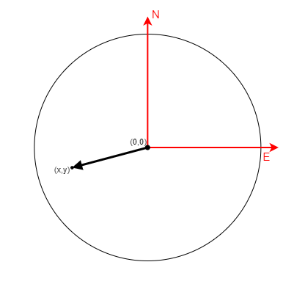
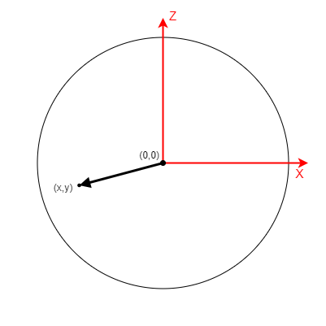
Synchronisation
V. Landmark positioning
Reality
Virtual

Slide 29


Synchronisation
V. Landmark positioning
Reality
Virtual

Slide 30
Synchronisation
V. Landmark positioning
Reality
Virtual

Slide 31

Synchronisation
V. Landmark positioning
Reality
Virtual

Slide 32
Synchronisation
V. Landmark positioning
Reality
Virtual

Slide 33
Synchronisation
V. Landmark positioning
Reality
Virtual

Slide 34
Demo

Slide 35

The abstract, concepts and ideas in this thesis were presented in the student section of the 33rd edition of the Arad Academia Days hosted by “Vasile Goldiș” Western University of Arad.

Slide 36
THANK YOU!

